Slide 1
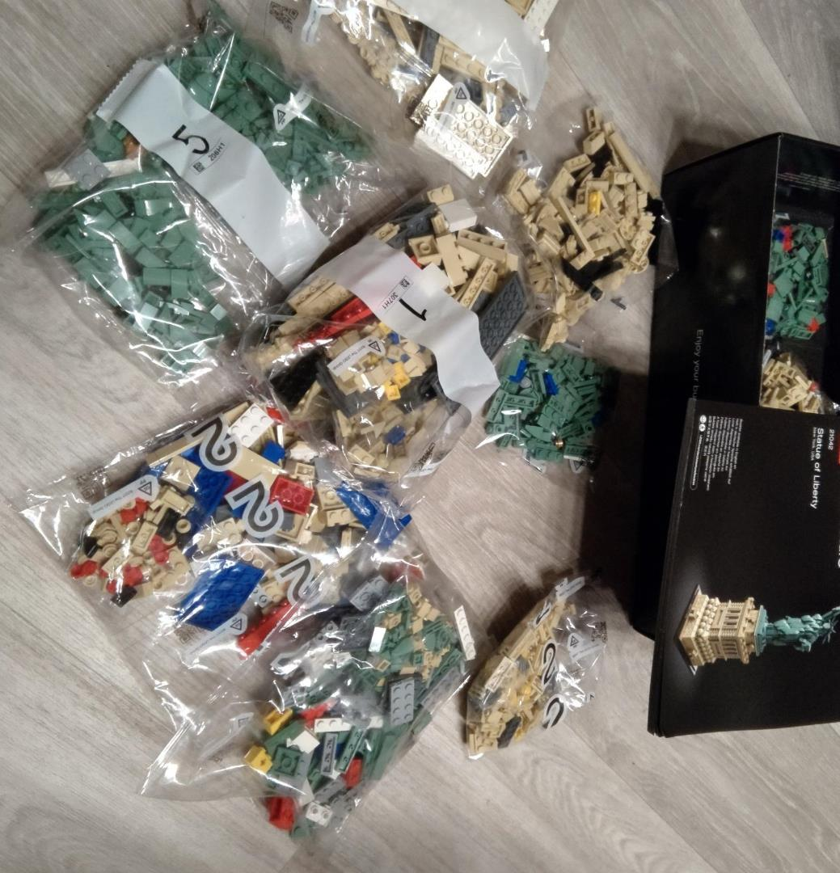
Jetpack Compose Workshop Thomas Künneth

Slide 2
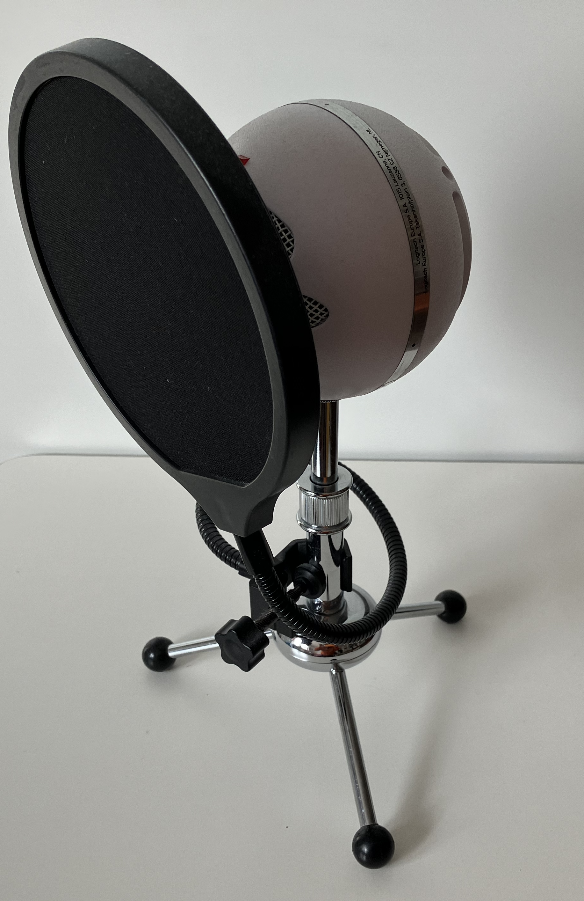
Welcome.
Let’s introduce ourselves.

Slide 3









@tkuenneth
@tkuenneth
@tkuenneth
@tkuenneth@androiddev.social

Slide 4
09:30 – 10:00 Introduction
10:00 – 10:50 Why declarative UI frameworks
11:00 – 11:50 Basics
12:10 – 13:00 Building UIs
13:00 – 14:00 🥗🍔🧃

Slide 5
14:00 – 14:50 Advanced topics
15:00 – 15:30 Interoperability
15:50 – 16:50 Looking at a real-world app
16:50 – 17:00 Wrap up

Slide 6
Prerequisites
A clone of the workshop repo at https://github.com/tkuenneth/compose_workshop
Android Studio, ideally Giraffe or later
Configured Android Emulator - or – physical device connected via USB port

Slide 7
Tech check
Switch to branch 00_initial_version of the compose_workshop repository (https://github.com/tkuenneth/compose_workshop)
Run the app to make sure everything works

Slide 8

Short break… 😍

